Slide 1
Welcome

Slide 2
Project Name : Smart Department
01
Md. Firose Mahmud
ID : 19201103003
SUPERVISOR
02
Md. Habibur Rahman Shohel
ID : 19201103027
Md. Anwar Hussen Wadud
Lecturer
03
Md. Arafat Hossain
ID : 19201103039
Department of Computer Science and Engineering
Bangladesh University of Business and Technology

Slide 3
ABSTRACT OF OUR PROJECT
We would agree that digital education enhances the learning experience of students by better engaging their attention and enabling them to grasp concepts more readily. It has changed the way education is imparted – a single query or doubt can be clarified in seconds online, there are innumerable resources available for a student online that add on to the classroom. Most of the student of a university have a computer. A student often does not find a lot of information easily or he/she fall in trouble to find the information from others. So, we decide to make an application which is “Smart Department”
Where this application helps the student of any department of BUBT by providing all necessary information. It may take up to 4 months.

Slide 4
What is the benefits of the project?
We have university website & BUBT Annex for online support of a student. But our main goal is to filter out all the benefits a department presents to students smartly.
The mentality of developing software and working in a team has been created.

Slide 5
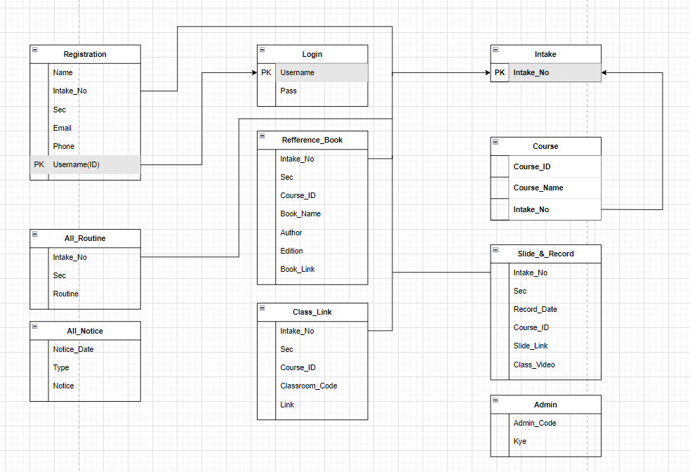
SCHEMA DIAGRAM OF OUR PROJECT

Slide 6
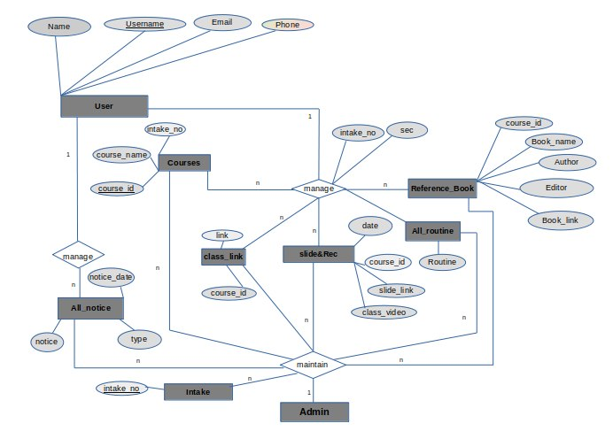
ER DIAGRAM OF OUR PROJECT

Slide 7
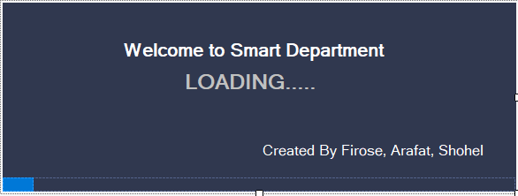
USER INTERFACE

Slide 8
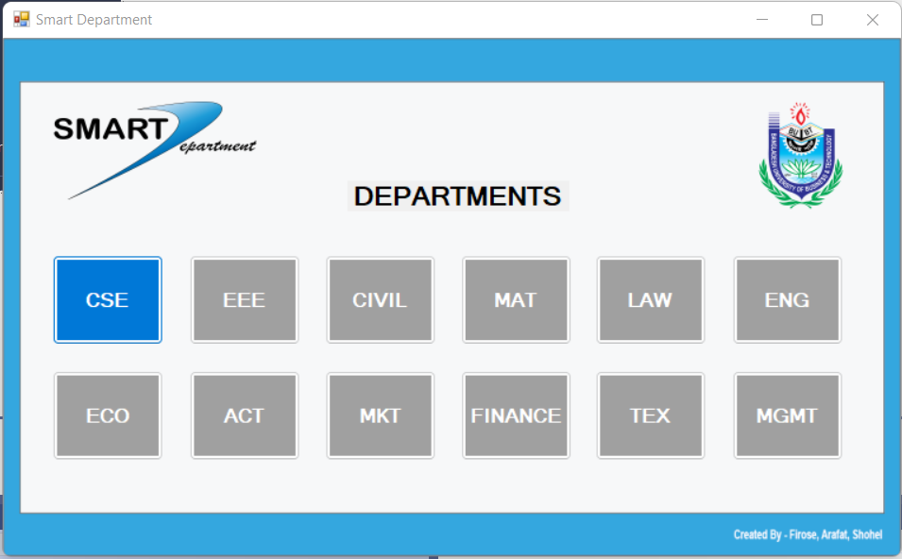

Slide 9
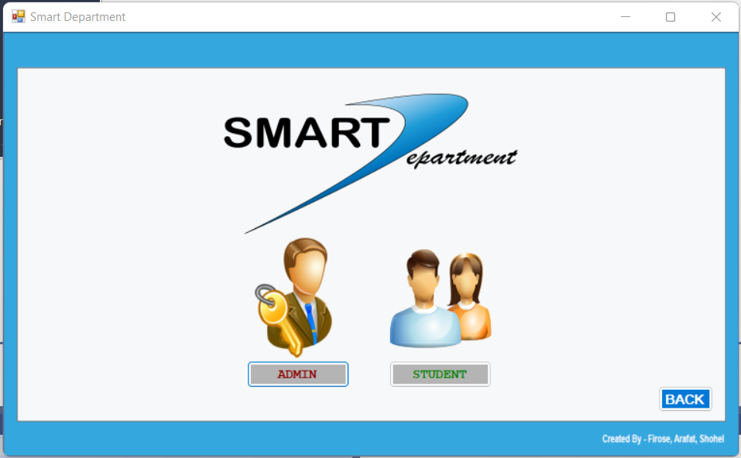

Slide 10
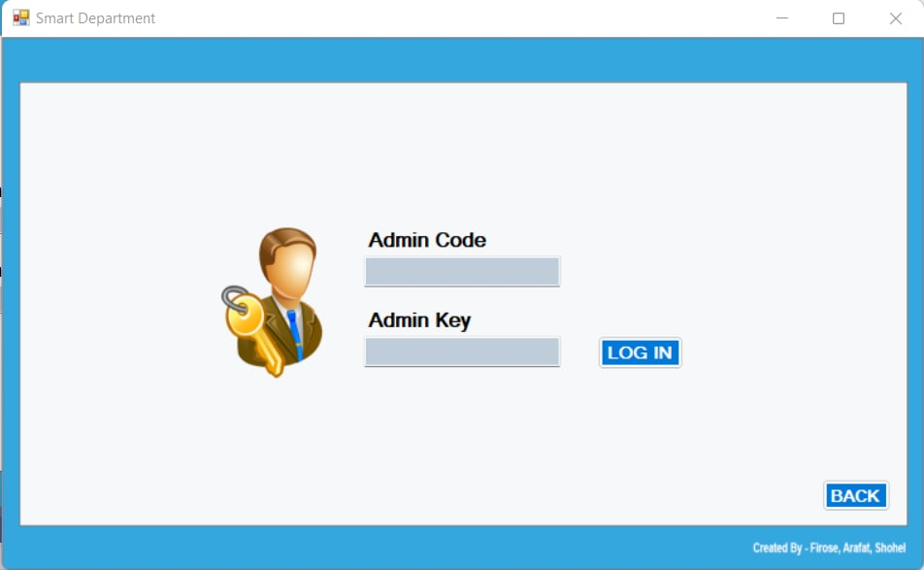

Slide 11
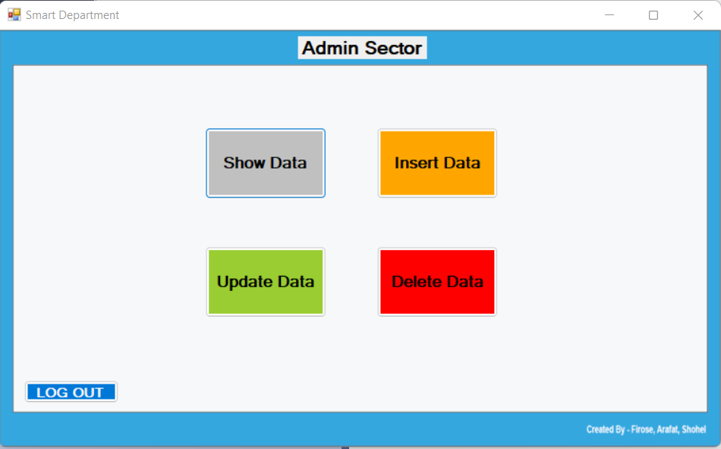

Slide 12
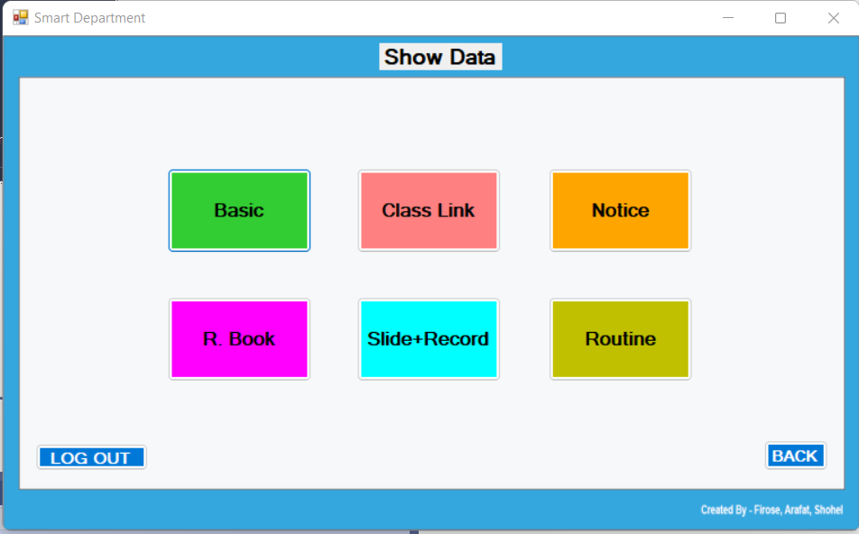

Slide 13
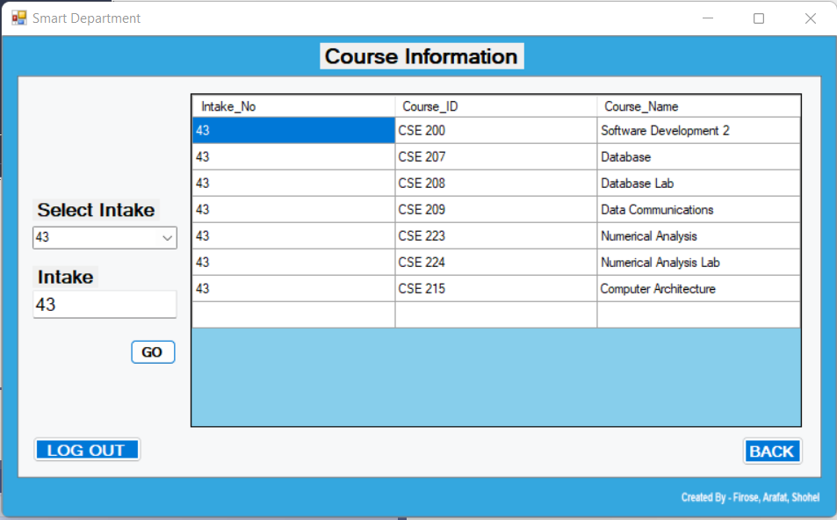

Slide 14
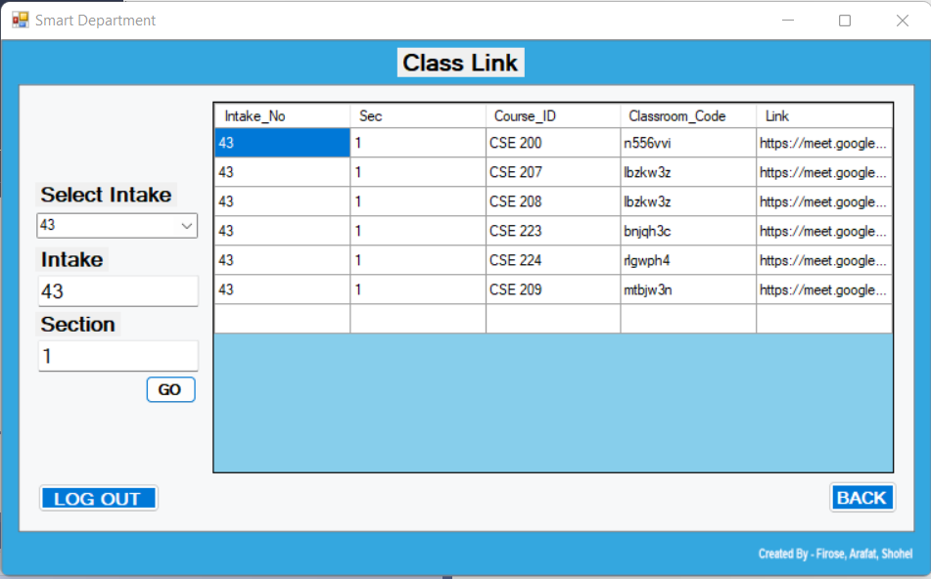

Slide 15
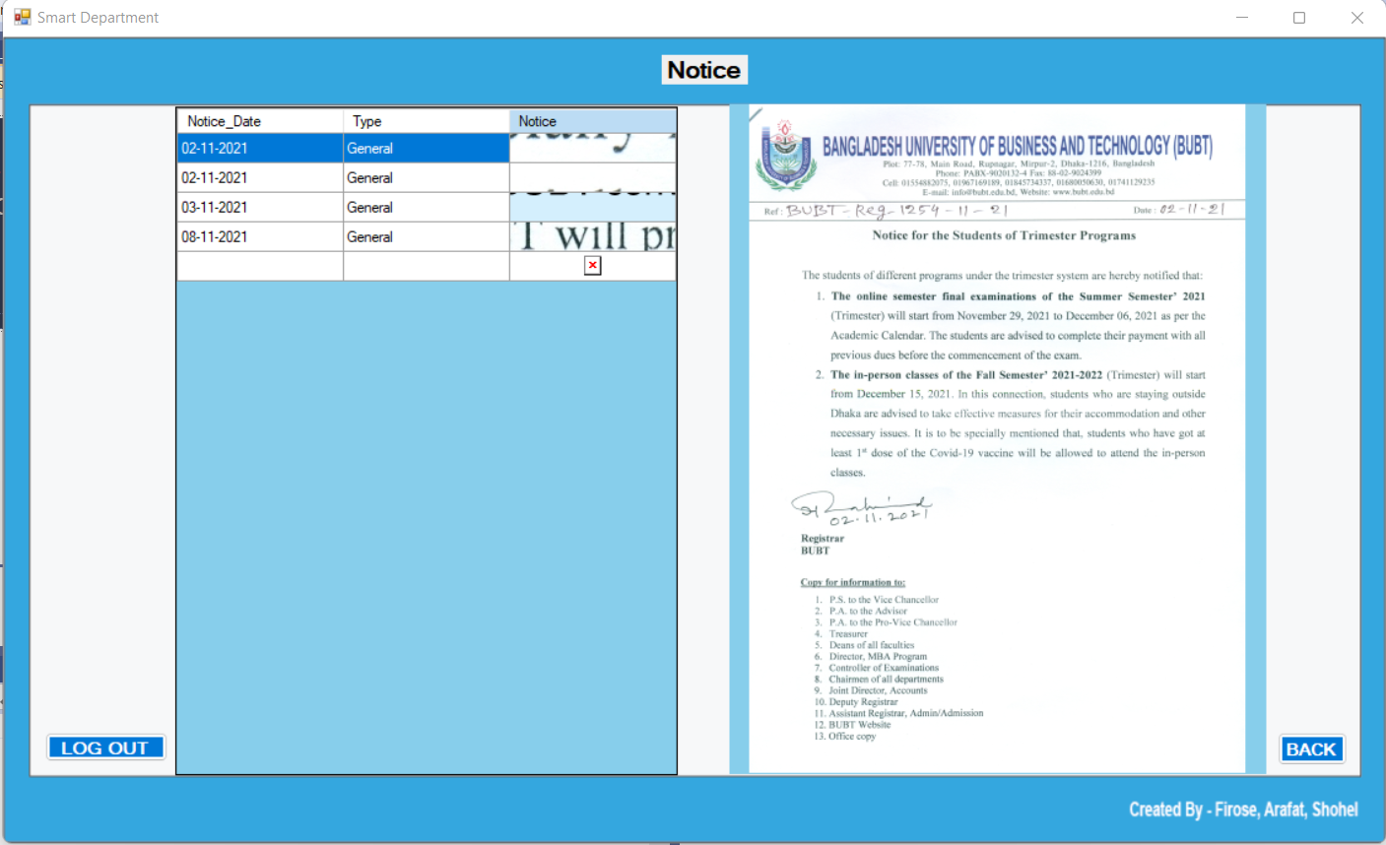

Slide 16
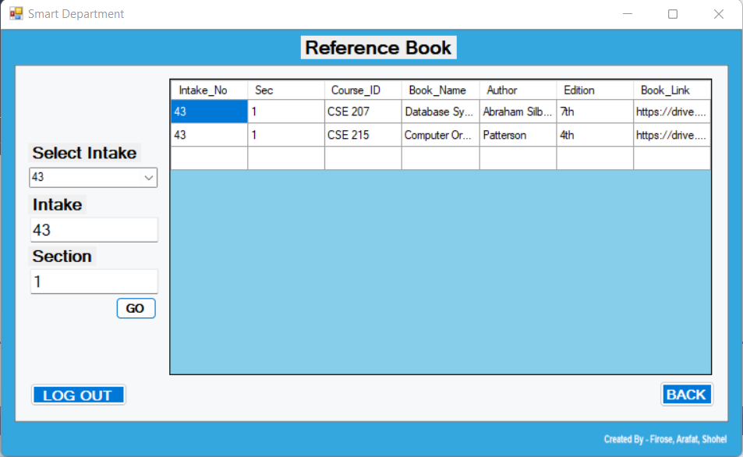

Slide 17
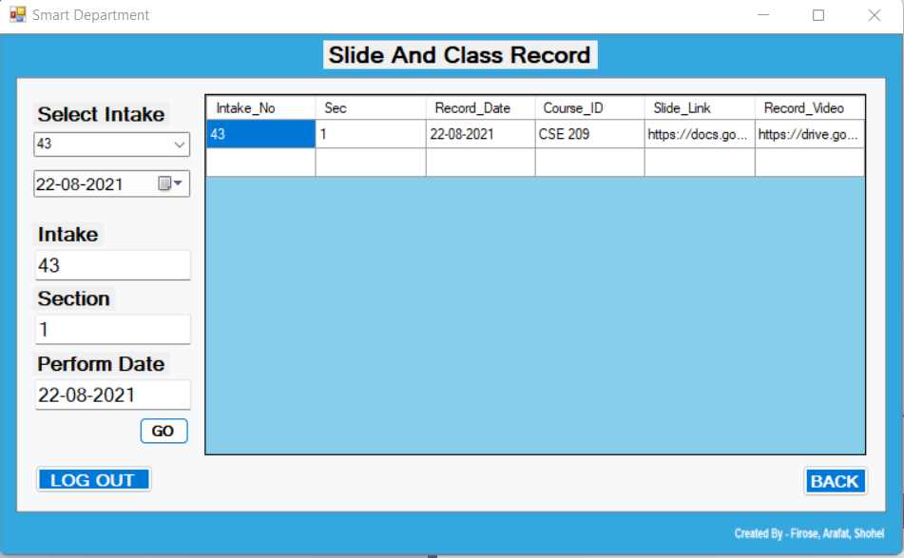

Slide 18
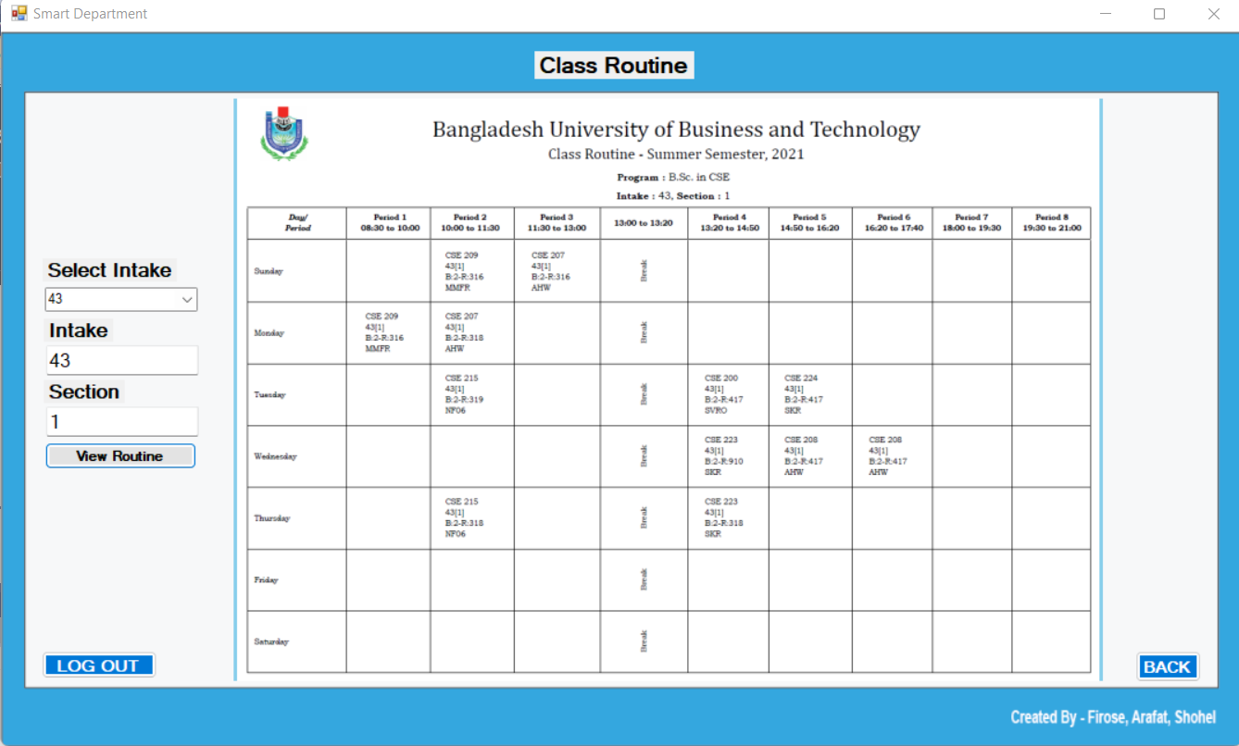

Slide 19
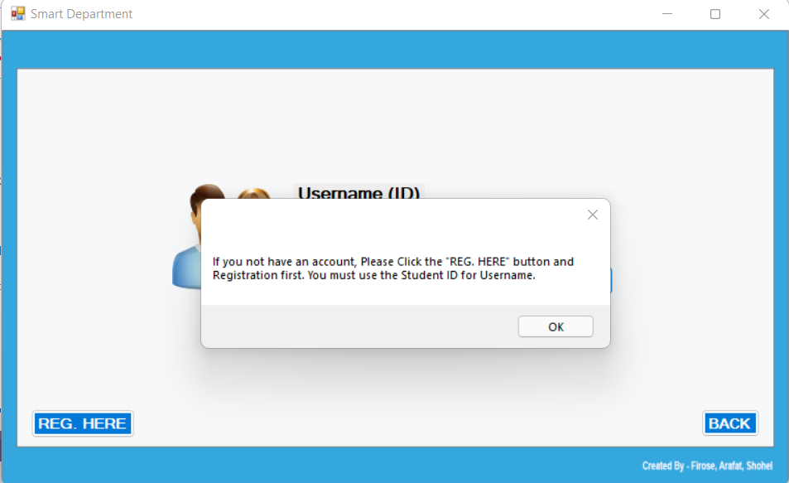

Slide 20
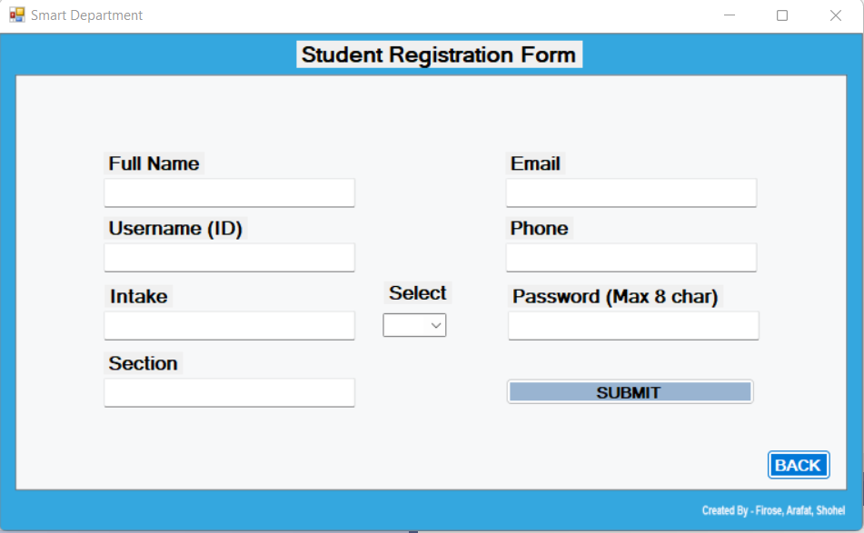

Slide 21
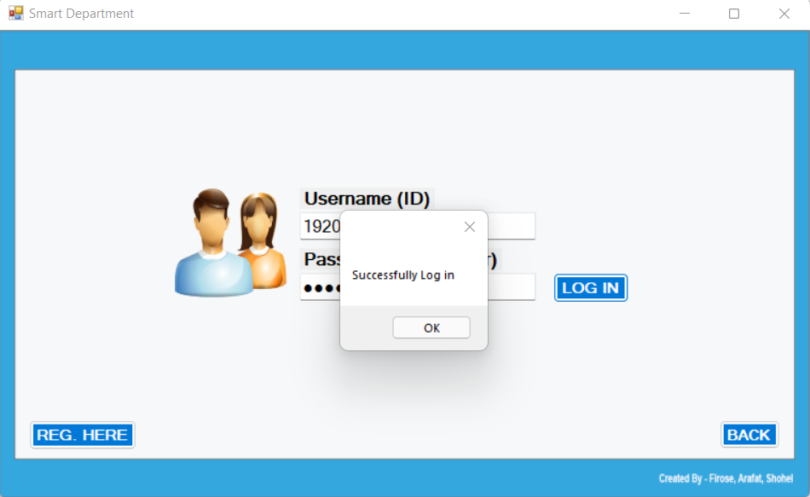

Slide 22
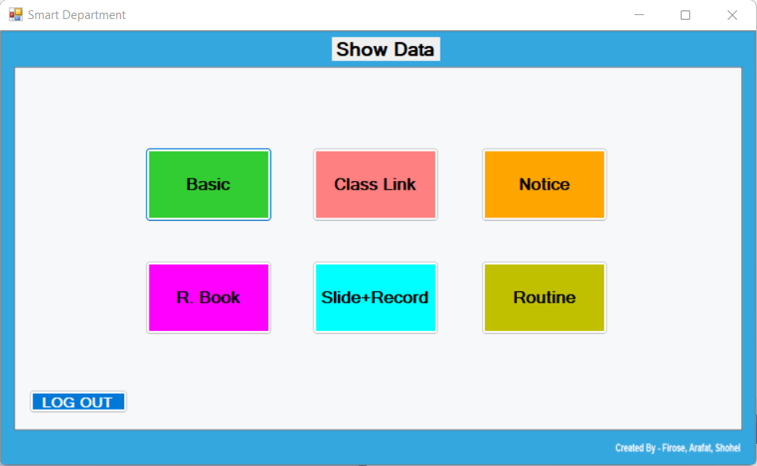

Slide 23
Limitations
• We have done only works on CSE Department as an example. In Future we will work for the others departments.
• In Admin Sector we didn’t work on Update and Delete Button for project time limitation.
•

Slide 24
What is our Future Plan?
We want to make this software more user friendly .
We will an option for reporting bugs for fixing bugs (if any) or suggestions for better support.
We will add an option as “Previous Question” for students if BUBT Authority allow us.

Slide 25

Do you have any query?

